Slide 1
BSTAT-5325 SECTION-003 GROUP–13 PROJECT PRESENTATION ON WORLD STATISTICS DATASET ANALYSIS
Presented By:
1. Prudhviraj Chowdary Balla Narayana Rao (1001993742)
2. Rohan Dasari (1001967606)
3. Ankita Phadke (1001963837)
4. Rushi Ashokbhai Thakker (1001870974)
Date: 12/02/2021

Slide 2
INTRODUCTION TO THE DATASET UNDER ANALYSIS
Dataset published by the World Bank, more than 318,420 total data points under analysis
Consists of 61 years data since 1960 till 2020; details of 261 countries – developed: 52, developing: 209
Includes country’s population, access to electricity, mortality, birth rates, gender-based employment data, agricultural land, forests area, GDP, life expectancy etc.
Sr No | Column Name | Type/Comment | Sr No | Column Name | Type/Comment
1 | Country Name | Text | 11 | Employment in agriculture | Number, (%)
2 | Year – data belongs to which year | Number | 12 | Employment in agriculture, female | Number, (%)
3 | Development status – developed/developing | Text | 13 | Employment in agriculture, male | Number, (%)
4 | Access to electricity - % population of country | Number, (%) | 14 | Forest area – area of land under forests | Number (sq. km)
5 | Access to electricity, rural - % rural population of country | Number, (%) | 15 | GDP Per capita – total GDP/population | Number (US$)
6 | Agriculture land – land under agriculture | Number (sq km) | 16 | Land area – total land area of country | Number (sq. km)
7 | Agricultural raw material exports | Number, (%) | 17 | Mortality rate, infant | Number
8 | Agricultural raw material imports | Number, (%) | 18 | Population, total | Number
9 | Birth rate, crude (per 1000 people) | Number | 19 | Population Density – total population/total land area | Number
10 | Death rate, crude (per 1000 people) | Number | 20 | Life Expectancy in years – how long do people live in the country | Number

Slide 3
MOTIVATION & KEY TAKEAWAYS
Motivation of the Analysis:
World data analysis is extremely important in urban and regional planning all over the world.
Comparative study between developed and developing countries, over past 61 years, indicates potential reasons and differences between growth of countries, economies and changing trends with time.
Factors like GDP, population, economic growth, employment, birth and death rates, land utilization can be utilized in planning and implementation decisions in various countries over the world.
Key Takeaways of the Analysis:
Form policies/strategies around agriculture, population, resources use. E.g.: reducing population density and improving availability of electricity in developing countries.
Provide recommendations to governments based on focus points for improvements. E.g.: Very high infant mortality rate in developing countries by improving medical facilities.

Slide 4
HIGHLIGHTS OF ANALYSIS
A country’s growth and development depends majorly on below factors:
Higher GDP Per capita, indicator of steady economic growth and strength
Ready availability of resources – both natural (e.g., ample land, water) and technological (e.g., electricity)
Resources should be usable by most of the country’s population, this would also improve overall living standards
Lower population density indicates that resources are lesser shared between population
Developing countries have higher lands under agriculture and forests compared to developed countries. Countries with larger arable lands provide more employment to its people in agriculture – both men and women, and they have higher agricultural exports which contributes to their revenue.
The overall birth and death rates of the world are declining, hinting towards better medical facilities, these rates are decreasing 50% faster in developed countries over developing countries.
However, higher infant mortality rates in developing countries are worrisome and demand attention. These rates are as high as 30% in developing countries. These rates are lower in developed countries, averaging at around 5%.
Life expectancy of the world is improving. Developed countries – 79 years ; Developing countries- 70 years

Slide 5
DATA CLEANING AND SCRUBBING STEPS
Case wise data deletion: Without impacting mean and SD, ignored missing data :
Employment in agriculture, both female, male
Access to electricity
Mean substitution technique: Replaced the intermediate values with the mean value of the overall trend:
Forest area
Agricultural imports and exports
Last observation carried forward: Replaced missing value at the end of the year range (years 2019, 2020) with the last known observation
Access to electricity
Birth Rate
Death Rate
Deletion of completely missing data at random: Deleted Average precipitation and Rural land area columns due to randomly missing data which couldn’t be utilized for analysis.
Additional columns introduced: Added life expectancy column to analyze correlation with birth, death, and mortality rates and prediction of average life expectancy in future.

Slide 6
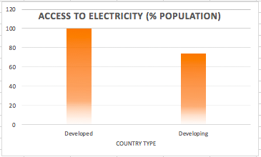
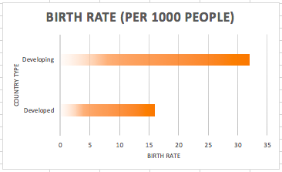
EXPLORATORY ANALYSIS – DEVELOPED VS. DEVELOPING, OVER YEARS
Variable | Findings and Comments |  | Visualization (Mean data over a span of 60 years)
1. % Population having ‘Access to electricity’ | Developed countries: 100% (>95%) Developing countries: 50% < Access to electricity <= 100% | Developed countries have more population who have access to electricity for people, promoting growth Higher value is indicator of country’s development
2.Birth rate of the country (per 1000 people, average for 60 years) | Developed Countries: Dropped by ~55% on an average through 60 years Developing Countries: Dropped by ~45% on an average through 60 years | However, average birth rate in developed countries is almost 50% of that in developing countries. Lower value is indicator of country’s development

Slide 7
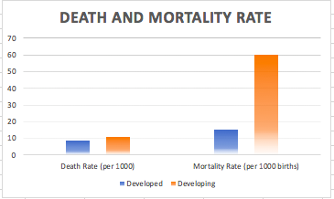
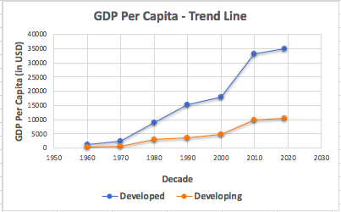
EXPLORATORY ANALYSIS – DEVELOPED VS. DEVELOPING, OVER YEARS
Variable | Findings and Comments |  | Visualization (Mean data over a span of 60 years)
3. Death and Infant Mortality Rate of the country (per 1000 people and 1000 new born children, average for 60 years) | Developed Countries: Both the rates are lower than developing Developing Countries: Much higher infant mortality rate in developing countries | Lower death rates and mortality rates point towards better medical facilities Lower values are indicators of country’s development
4. GDP Per Capita (Directly affects country’s development, more for developed countries) | Developed countries: Increased ~ 31 times through 60 years Developed countries: Increased ~ 36 times through 60 years | Higher GDP per capita is a clear indicator of economic growth of the county Developed countries’ GDP is multiple times that of the developing countries

Slide 8
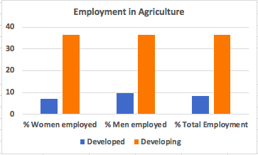
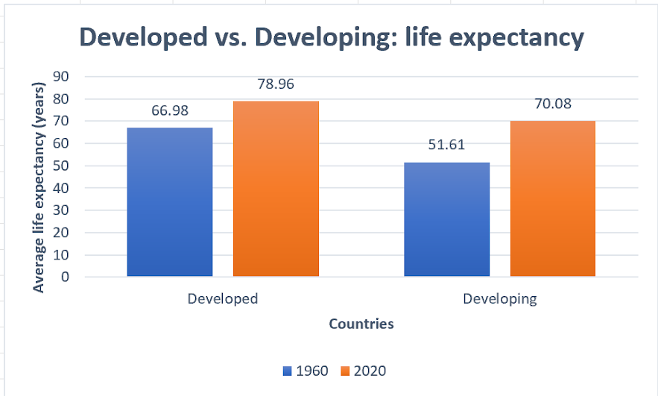
EXPLORATORY ANALYSIS – DEVELOPED VS. DEVELOPING, OVER YEARS
Variable | Findings and Comments |  | Visualization (Mean data over a span of 60 years)
5. Agricultural employment (% of the country’s total employment) | Developed countries: Average lies around 8% Developing countries: Average lies around 36% | More no. of people have Agriculture as primary/significant occupation in developing countries
6. Life expectancy trends | Developed countries: Avg. value increased from 70 to 79 years in last 60 years Developing countries: Avg. value increased from 51 to 70 years in last 60 years | Developed countries have higher life expectancy Higher values are the effects of the growth and overall better medical facilities

Slide 9
PREDICTION OF COUNTRY’S FUTURE DEVELOPMENT STATE
Prediction and classification of country’s development status as: a) Developed b) Developing
Technique used: Classification Tree Analysis, Tool used: JMP From SAS
Classification tree: Outcome is categorical – developing (0) or developed (1)
Trends for classifying countries into developed and developing:
Access to electricity – Developed countries have more than 99.95% (~100%) people having access to electricity
GDP Per Capita- Developed countries have high GDP per capita.
Population Density- Developed countries show low population density.
Developed countries with higher values in population density, have very high GDP supporting strong economy
e.g.: Hongkong, Singapore
Developed countries with very low population density of < 5 people per sq. km. have very high GDP ~ USD 60,000, since resources are shared within very less no. of people e.g.: Australia, Canada, Iceland
Electricity availability and GDP Per capita are very important factors for development.
For a country to be classified as developed:
GDP Per capita should be higher than USD 13,000 and population density should be lower than 1,700
Other criteria classify the country as developing

Slide 10
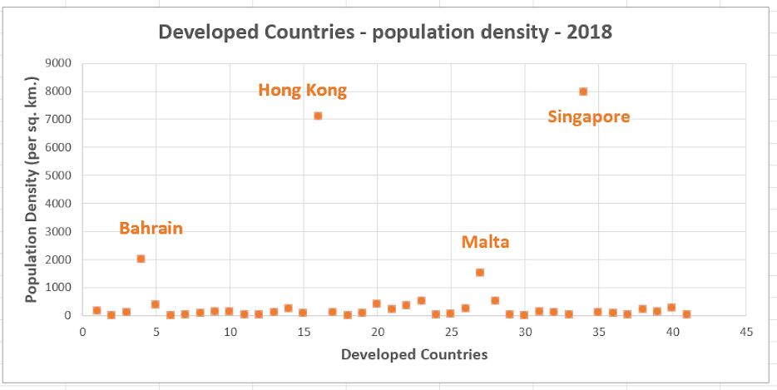
PREDICTION OF COUNTRY’S FUTURE DEVELOPMENT STATE
Outliers and interesting observations found during CTA:
Developed countries which have very high population density ( >1000 people per sq. km.):
Average population density for all the other developed countries: 348 people per sq. km.
These countries are developed despite high values in population density, due to stronger economic backing.
Future development state prediction: country: India in 2050 (currently: developing)
GDP/capita (projected) | Population Density (projected) | Access to electricity % (projected) | Year | Prediction | Note
USD 53,000 | > 500 | 100% | 2050 | Developed | * India is projected to be the world's second-largest economy by 2050 *

Slide 11
AGRICULTURAL TRENDS USING CLUSTERING
Identify similarities and groups within countries based on Agricultural factors
Technique used: Cluster Analysis (K-means Clustering), Tool used: JMP From SAS, Minitab
Trends observed: Agriculture continues to be the focus in developing countries and not much in developed countries.
Agriculture Land (sq. km.) – developed countries have lower area under agriculture than developing
Agricultural imports: for developed countries, imports are 2%, for developing imports are 5-7% of total
Agricultural exports: for developed countries, exports are 2%, for developing exports are 7-8% of total
Developed countries: Identified that the countries USA, Australia & China are developed countries that have higher land under agriculture, imports and exports, which is not a common trend in developed countries.
Australia: Has the highest amounts of agricultural exports than most of the developed countries (3%)
China: Has the highest amounts of agricultural imports than most of the developed countries (4%)
Developing countries: Identified that the countries India & Brazil form a unique cluster with high available agricultural lands and imports and exports, along with Kazakhstan, Russia, Saudi Arabia. We can conclude that these are agriculture proficient countries. (agricultural land > 2,700,000 sq.km., exports > 5% in 2015)

Slide 12
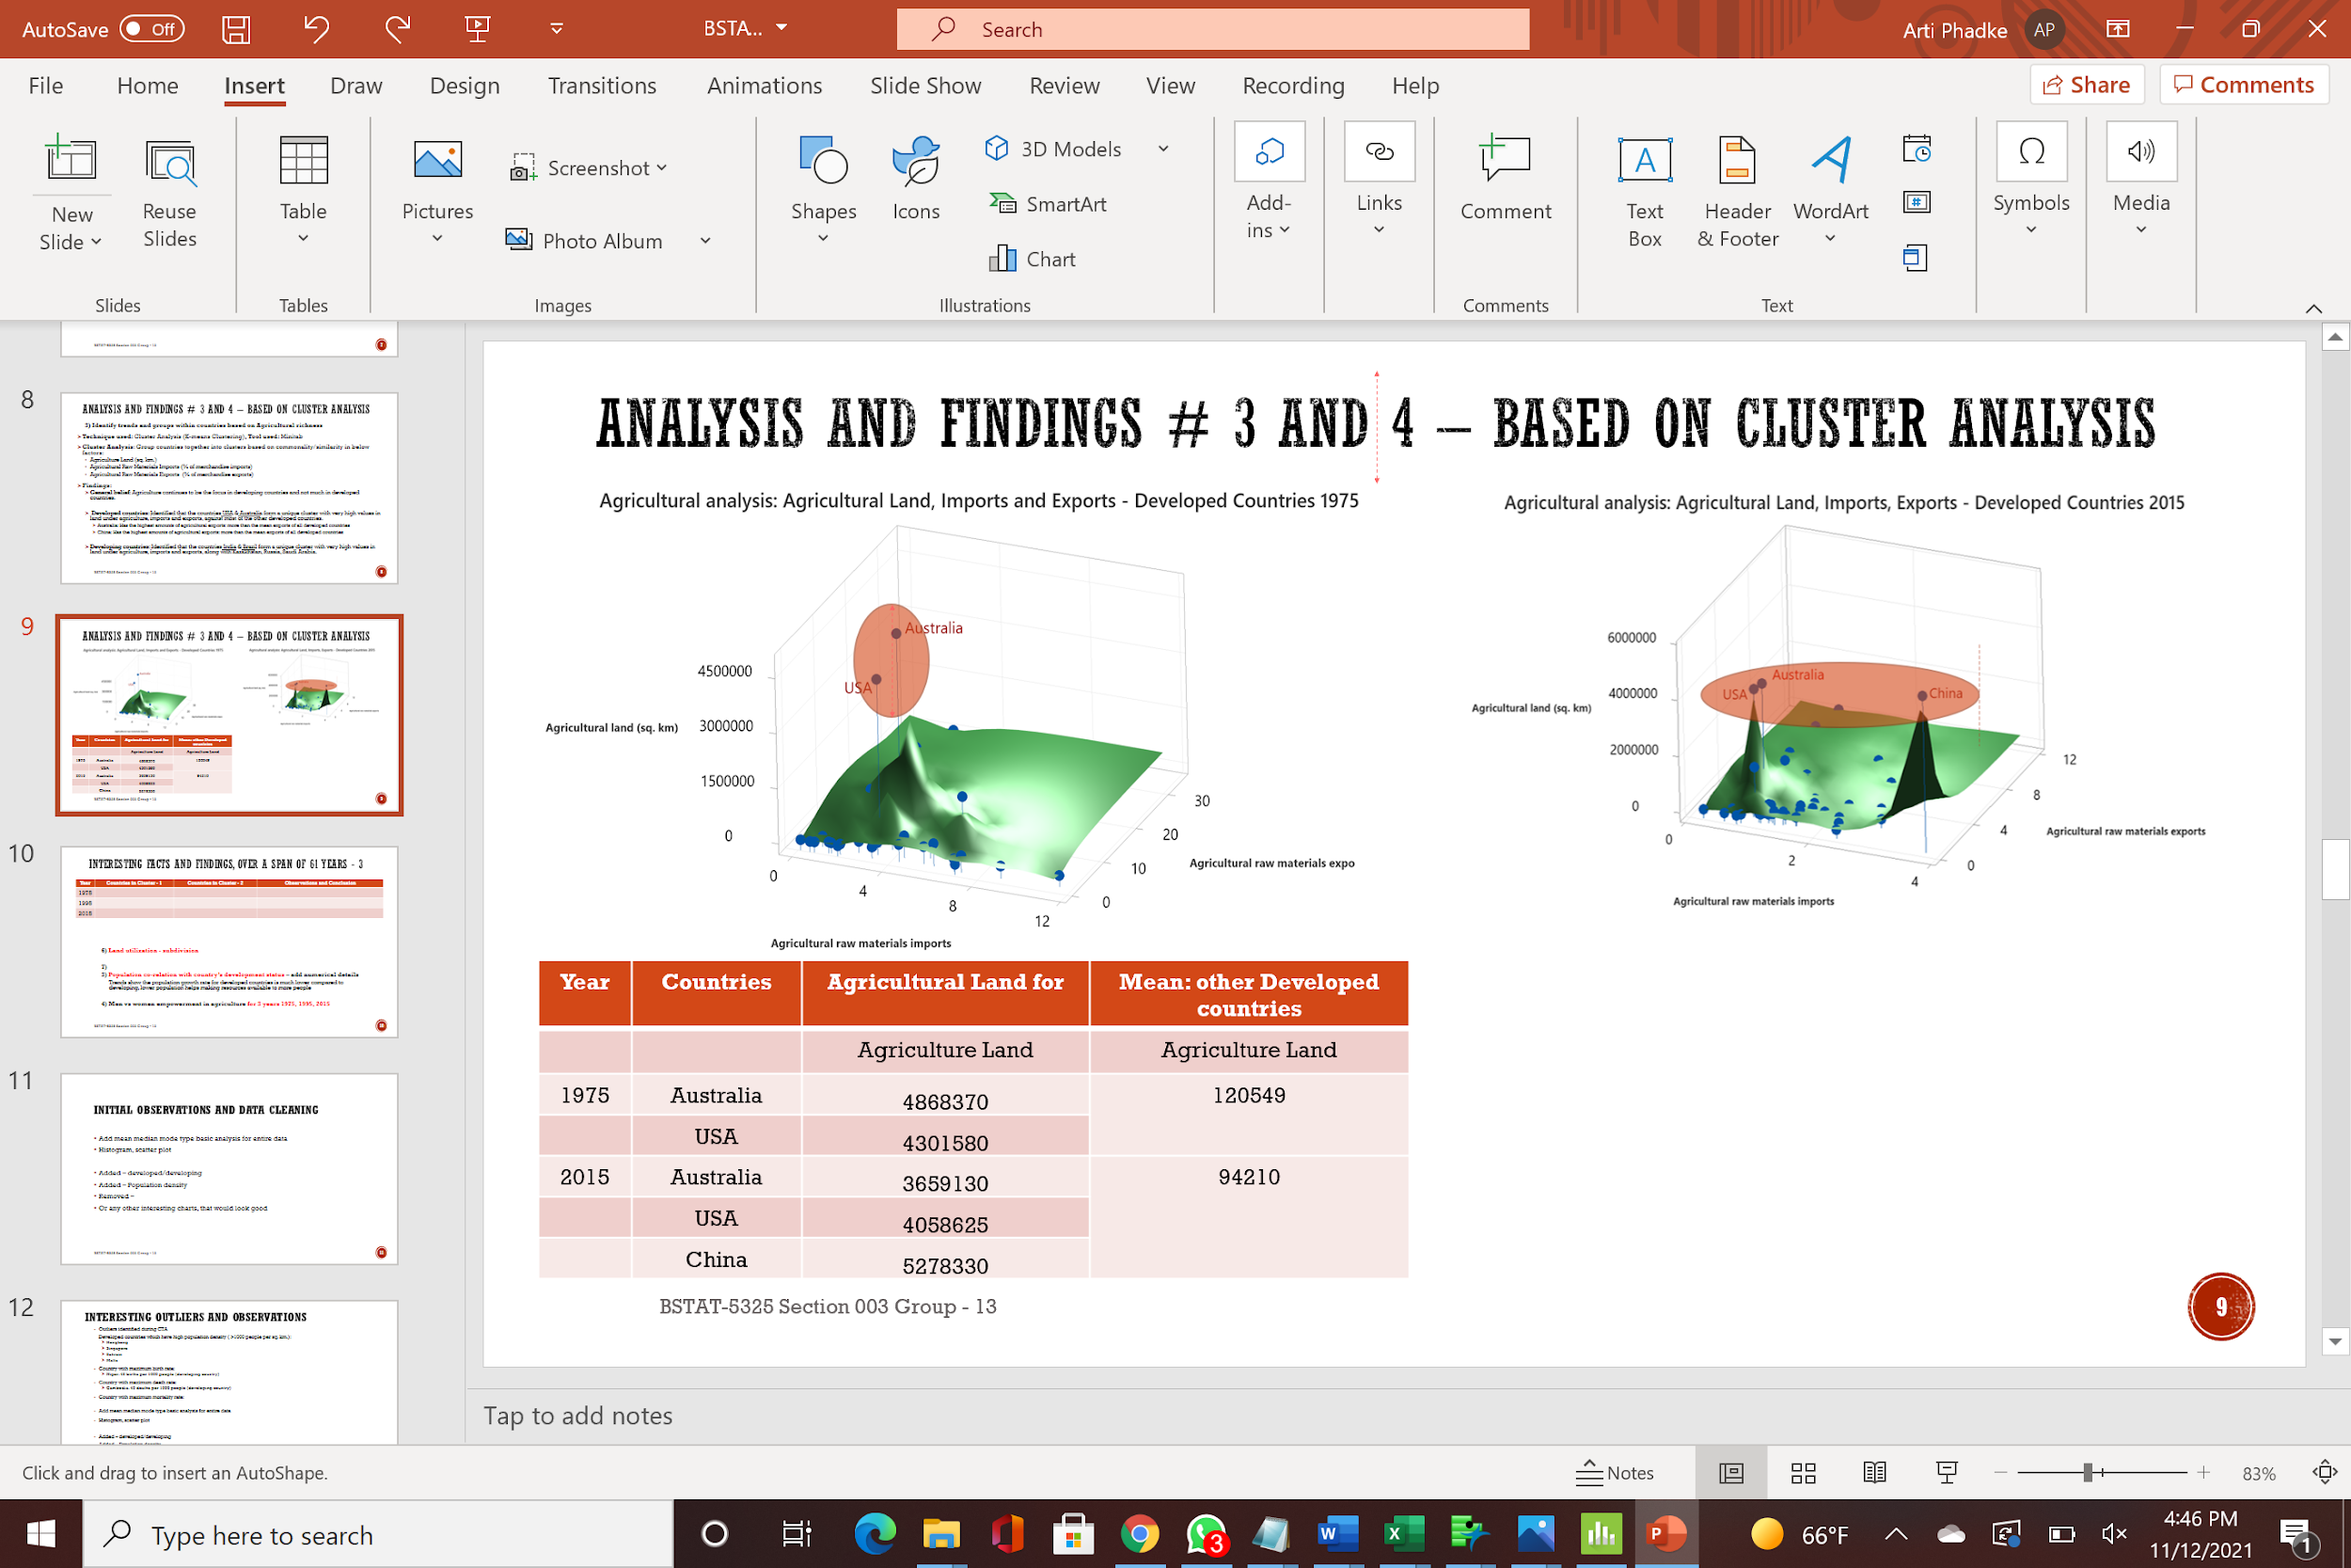

AGRICULTURAL TRENDS USING CLUSTERING
Agricultural observations outliers during 1975 and 2015, in developed countries
Developed Countries: 1975 and 2015
Year | Countries (Cluster 3) | Agricultural Land (sq.km) | Mean Agri. Land: Other Developed Countries (sq.km.)
1975 | Australia | 4,868,370 | 120,549
 | USA | 4,301,580
2015 | Australia | 3,659,130 | 94,210
 | USA | 4,058,625
 | China | 5,278,330

Slide 13
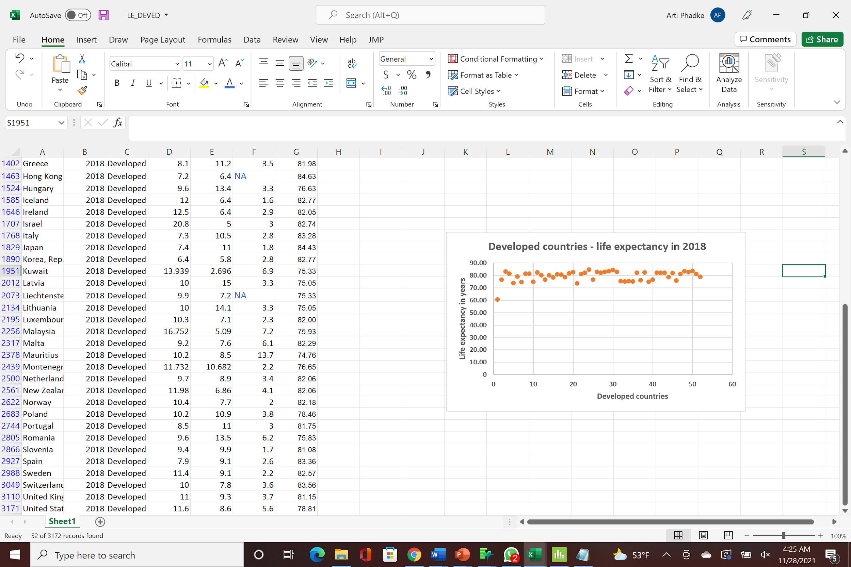
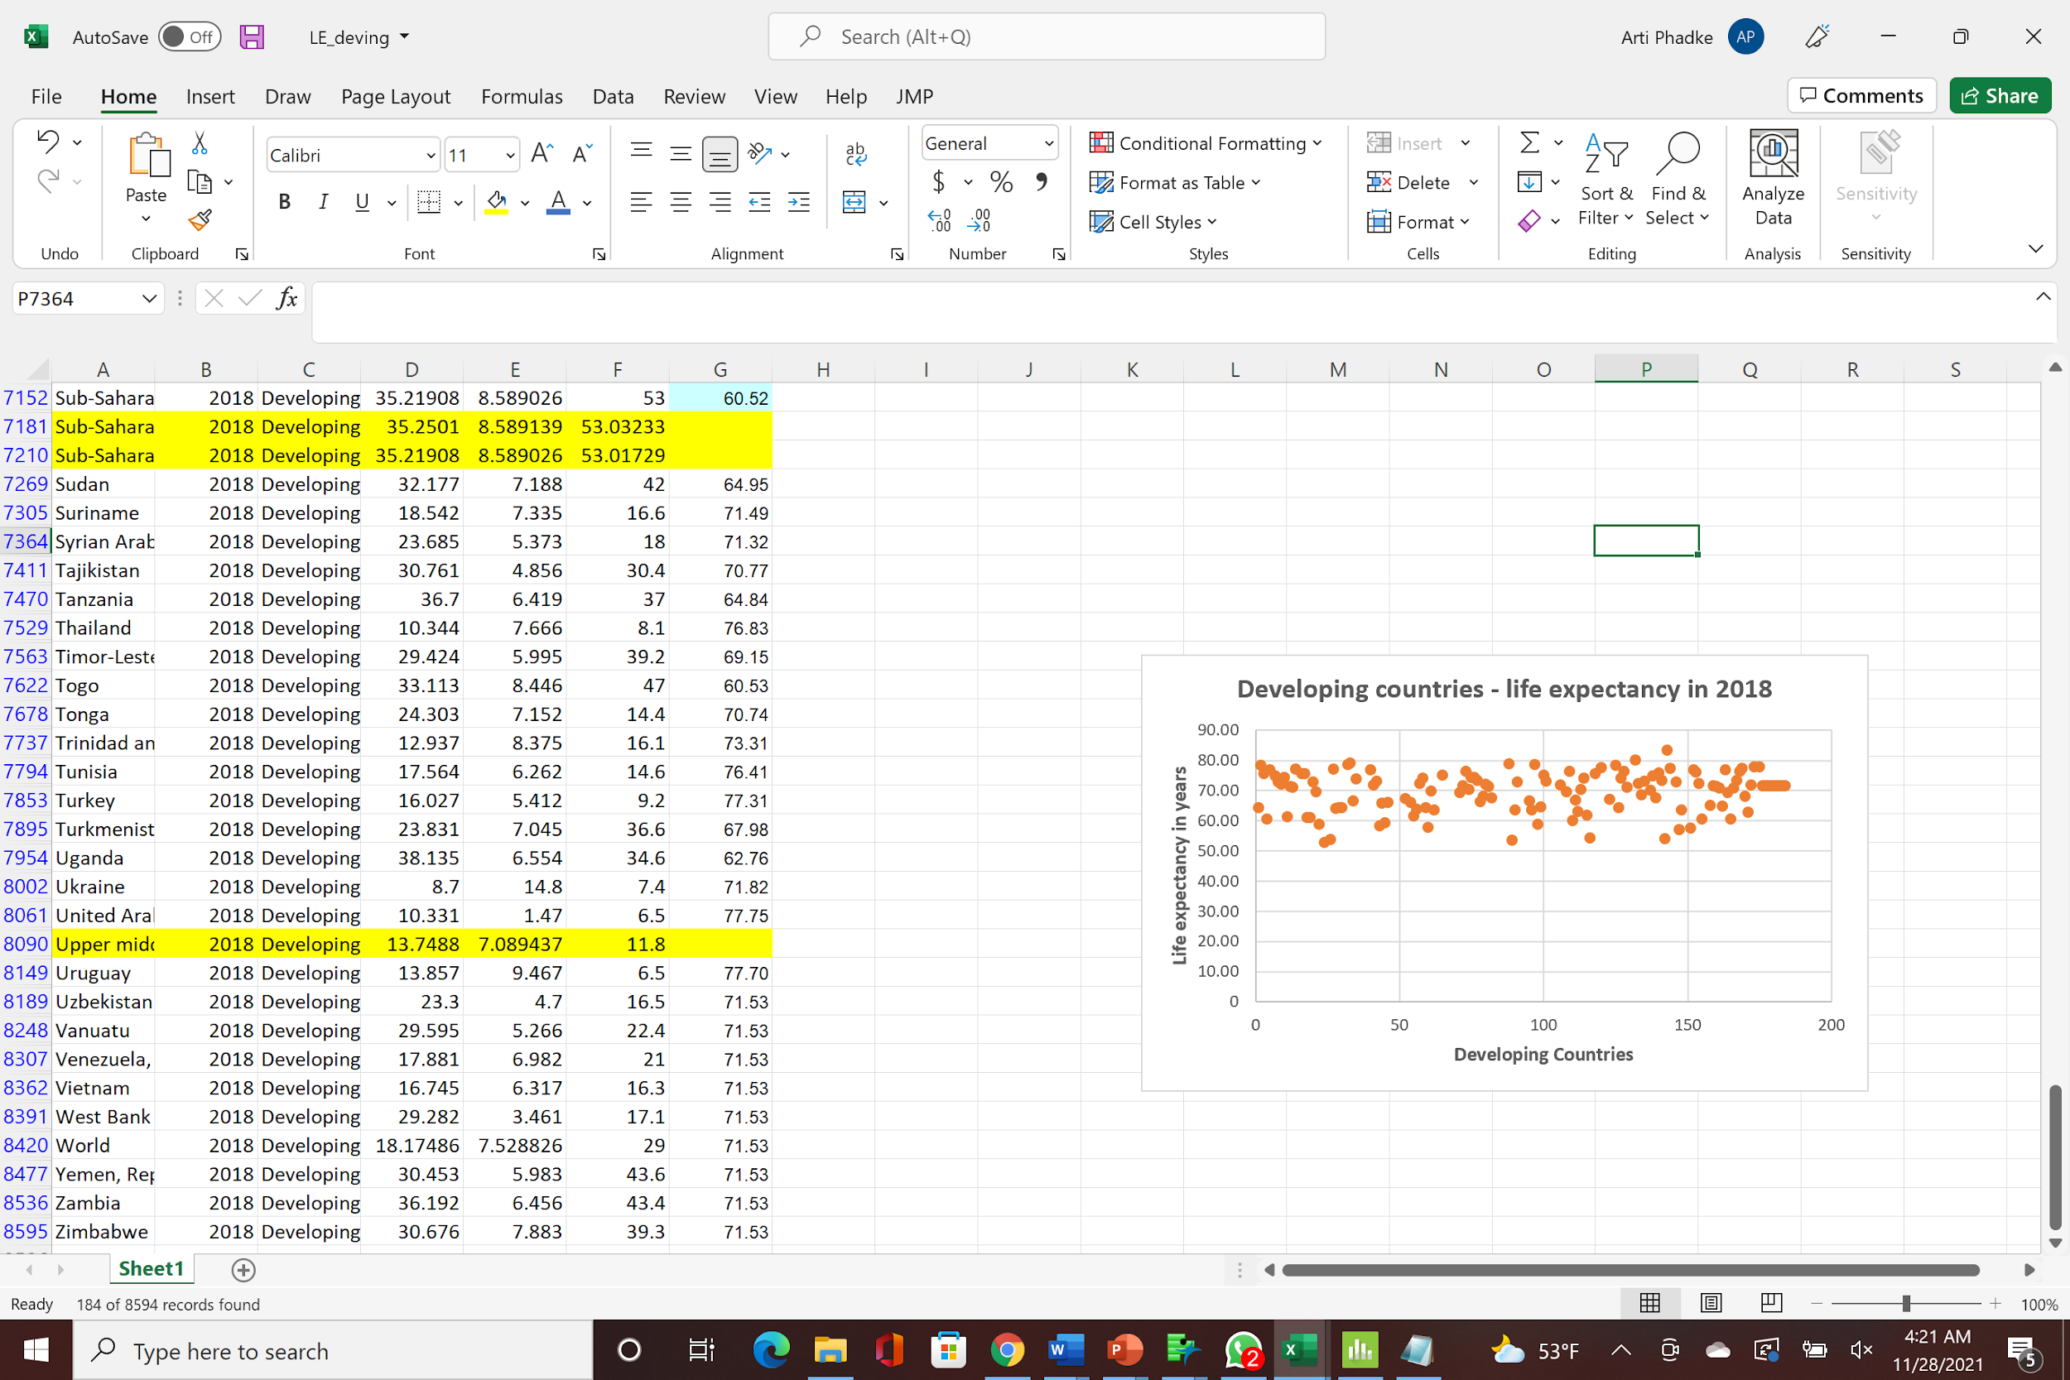
PREDICTION OF LIFE EXPECTANCY OF COUNTRY
Determination of the country’s life expectancy in years
Technique used: Regression Tree Analysis, Tool used: Minitab
Regression tree: Outcome is quantitative value: life expectancy of a country
Variables of interest/Inputs used:
Birth rate – developed <15 (per 1000), developing < 30 (per 1000)
Death rate – developed < 8 (per 1000), developing < 12 (per 1000)
Mortality rate – goes as high as 60 (per 1000) in some developing countries
Findings:
Life expectancy in developed countries is higher than developing
Lower death and mortality rates help improve the life expectancy in
developed countries
In 2018, developed countries life expectancy was between 73 – 83 years
In 2018, developing countries life expectancy was between 50 – 85 years
5 developing countries with lowest life expectancy in 2018 (< 55 years)
Central African Republic, Chad, Lesotho, Nigeria, Sierra Leone

Slide 14
PREDICTION OF LIFE EXPECTANCY OF COUNTRY
Comparative study between developed vs. developing, comparing some leaf rules showing mean life expectancy
2 different regression analysis – for 1) developed and 2) developing highlight difference in mean values & rules
Developed Countries |  | Developing countries
Birth, Death and Mortality rates | Mean Life expectancy | Birth, Death and Mortality rates | Mean Life expectancy
Birth rate <= 15.3515, Death rate <= 3.802, 8.55 < Mortality rate <= 49.9 | 42.44 years | Death rate > 37.4215, Mortality rate > 64.85 | 20.32 years
82.7 < Mortality rate <= 83.9 | 50.00 years | 23.978 < Death rate <= 37.4215, 64.85 < Mortality rate <= 226 | 39.10 years
Mortality rate > 83.9 | 59.41 years | 20.7415 < Death rate <= 23.978, 64.85 < Mortality rate <= 226 | 43.72 years
Birth rate > 30.605, 49.9 < Mortality rate <= 82.7 | 62.39 years | 18.275 < Death rate <= 20.7415, Mortality rate > 64.85 | 46.55 years
Birth rate <= 30.605, 49.9 < Mortality rate <= 82.7 | 66.23 years | 11.9695 < Death rate <= 14.035, Mortality rate > 64.85 | 55.28 years
Death rate > 3.802, 20.65 < Mortality rate <= 49.9 | 69.58 years | 20.7415 < Death rate <= 37.4215, Mortality rate > 226 | 58.81 years
Death rate > 3.802, 13.85 < Mortality rate <= 20.65 | 71.54 years | 6.703 < Death rate <= 8.307, 34.25 < Mortality rate <= 64.85 | 65.24 years
Death rate > 11.15, 4.45 < Mortality rate <= 8.55 | 74.73 years | 23.85 < Mortality rate <= 34.25 | 69.25 years
4.4495 < Death rate <= 11.15, 4.45 < Mortality rate <= 8.55 | 77.42 years | 10.05 < Mortality rate <= 15.65 | 72.92 years
Death rate > 4.4495, Mortality rate <= 4.45 | 80.35 years | Mortality rate <= 10.05 | 76.06 years

Slide 15
CONCLUSION AND RECOMMENDATIONS
Higher GDP, ready availability of resources like electricity to majority of population, lower population of country contribute to economic growth and development of country as the resources shared between lesser population, increase per head usability.
In general, ~ 100% population having electricity access, GDP higher than USD 13,000 and population density lower than 1700 identify a developed country.
Birth and death rate improvements suggest enhanced medical facilities have helped these figures progress all over the world, at a faster pace in developed countries. Average life expectancy trend in the world is improving, which indicates evolution of public healthcare, faster in developed countries.
Developing countries should focus to improve on infant mortality rates by providing better medical facilities, developed countries should have moral obligation to help developing countries.
Developing countries have Agriculture as a major population which also provides employment to population. They also have higher agricultural imports and exports. Developed countries have lesser reliance on agriculture as a profession, with exceptions of USA, Australia, China who also are agricultural proficient countries, being developed.

